Slide 1
BFX AT-100 FHD channel (live) noise FA report
Prepare by: PE – JUSTIN
Date: 2025/05/29

Slide 2
Problem Description
Issue Description (5W2H)
When | 2025-May-24
Who | SH Son
Where | ALT customer side, Location : SK networks warehouse, Anseong, Korea.
What | ALT customer complain 1pc T99X171.00 have FHD channel (live) suffers from image noise
Why | TBD
How | NG product FHD channel (live) image noise: S/N range: 2149688001202503069476
How much | 1pcs / 60.000 pcs ~ 0.00166% (Qty inspection lot 60k delivered on 2025.4)

Slide 3
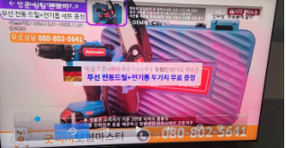

Confirm Fail Symptom
Customer feedback:
Symptom: FHD (1920 x 1080 pixel) channel live suffers from image noise (S/N: 2149688001202503069476)
Visual check -> No found abnormal.
Update check -> No found abnormal
+ By USB and By USB burning tools
Youtube video, UHD channel (live) -> No found abnormal.
FHD channel (live) image noise
FHD channel (live) image OK
Summary:
NG product have FHD channel (live) (1920 x 1080 pixel) suffers from image noise

Slide 4
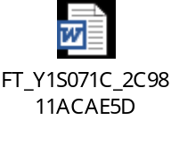
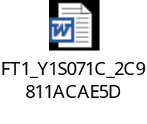
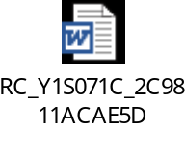
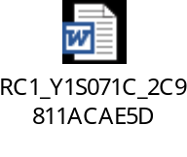
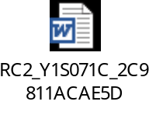
Production History Data Checking
T Level data (SMT)
SN | Test Station
Y1S071C | SMT LOADING | INSP-OUTSIDE | PCB_STOCKIN
 | 2025-03-14 16:25:11 | 2025-03-17 20:44:18 | 2025-03-17 22:02:13
Dot Level data (FATP )
S/N range | Test Station
2149688001202503069476 | UK | FT | FT1 | RC | RC1 | RC2
 | 3/22/2025 11:26 | 3/22/2025 11:34 | 3/22/2025 11:42 | 3/22/2025 12:02 | 3/22/2025 12:20 | 3/22/2025 13:17
Test logs | UK test haven’t logs test
Summary:
- This unit has PASSED normally SMT and FATP.
- Shipping date: 2025/03/26 2:45AM

Slide 5
Coverage checking
Re-check all items test at FAC
T99X171.00 TEST FLOW
A
SMT
UK
FT
FT1
FT3 (5%)
B
Auto copy flash by burning Tool
Adb Connect DUT
Check Firmware Version
LED Test
Check LED Isolation
Write Serial Number
Check Soc SecureBoot
Check Memory
Check Usb Storage
Check resolution 2160p60Hz
Check HDMI video noise
Check VP9 video on TV
Check 4K video on TV
Check Video Res 3840X2160
Check Video Fps 0x3c
Check USB3.0 Link Speed
Unmount USB
Check Firmware Version
Push file key
Write MAC & Bluetooth MAC
Check OTT Key
Write Keys
Test TX, RX throughput
Check LED
Test Remote IR
Check USB2.0 LinkSpeed
Check Audio 4K
Check Audio Record
Check HDMI HEVC HDR10+ Video
Check HDMI VP9 Video
Check HDMI H265 Video
Check Screen Shake
Check scan BT
Unmount USB
Check Device Alive
Login DUT
LED Test
Check Firmware Version
Read DUT Info
Check Burnin
Check CPU Temperature
Test Remote IR
Check Usb Storage
Check res 2160p30Hz
Check scan BT
Check Audio 4K
Check HDMI VP9 Video
Check HDMI H265 Video
Set Burnin off
B
RC
RC1
OBA
RC2
FG
C
Check Firmware Version
Read DUT Info
Check HDCP Checksum
Download Apk Remote file
Adb Connect DUT
Test Channel BT-Up
Test Channel BT-Down
Reset Relay
Check button
Check Bluetooth RSSI
Download Customer FW from USB
Unmount USB
Check Barcode.txt File
Read Data QR Code
Save keys to database
Check Product Bootup
Check SN, MAC ETH, Version, build
Check USB 3.0
4K Youtube Inspection
Check Voice
Bluetooth function Inspection
Reset Setting inspection
Check Result.txt File
Read Data QR Code
Check SN from database
Check Data LINK
Summary:
*FATP don’t test FHD channel (live).

Slide 6
Summary
No.# | Items | Result
1 | Confirm Fail Symptom | - Customer feedback 1pc have FHD (1920 x 1080 pixel) channel live suffers from image noise
2 | Production history | - No abnormal
3 | Coverage | - FATP don’t test FHD channel (live) - OBA station can’t test FHD channel (live)
*NEXT FA:
- Request customer return NG sample to Vietnam for us to analyze further.
- We need ALT customer support how to check FHD channel (live) at factory.

